Slide 1
Lunar Meteoroid Ejecta Model
Anthony M. DeStefano
NASA/MSFC/EV44 Natural Environments
11/17/2020

Slide 2
Overview
Results of LuMEM
Igloo number flux distribution (based on MEM3, see Moorhead et al 2019)
Example DSNE Table for Rev. I
HVIT Probability of No Penetration (PNP) Comparison
DSNE Rev H Lunar Ejecta Model – NASA SP-8013 (1969)
Based on Zook 1967
Brief (non-exhaustive) Review of Impact-Ejecta Scaling Models
Zook 1967
Krivov et al. 2003
Housen & Holsapple 2011
Proposed New DSNE Model -- Meteoroid Model of Secondary Ejecta (MeMoSeE)
Sporadic meteoroid flux (Grun et al 1985)
Near Earth Object (NEO) flux (Brown et al 2002)
Impact-ejecta scaling model (Housen & Holsapple 2011)
Ejecta particle size distribution (Carrier 2003)
Ejecta zenith angle distribution (empirically from Gault & Wedekind 1978)
Ejecta azimuth angle distribution (modified from Rival & Mandeville 1999)
Analytic model of lunar ejecta
Speed distribution as a function of distance
Secondary flux as a function of distance
Secondary flux in terms of primary flux

Slide 3
Ground Rules and Assumptions (GRA)
The ejecta particle distribution and density is the same as the virgin regolith particle distribution and density.
The scaling law provided by Housen and Holsapple 2011 is valid for all impactors simulated in our model.
The ejecta azimuth and zenith angle distribution functions are given empirically and do not depend on the size of impact or speed of impact, only the impact angle and azimuth.
The regolith density is constant over the whole Moon and for all depths.
The Moon is a perfect sphere with a mono-polar gravity well (i.e., we ignore irregularities in the lunar surface and gravity).
The angular distribution of NEA’s on the lunar surface are modeled after the helion/antihelion population provided by MEM3.

Slide 4
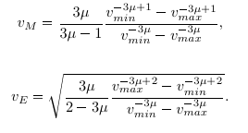
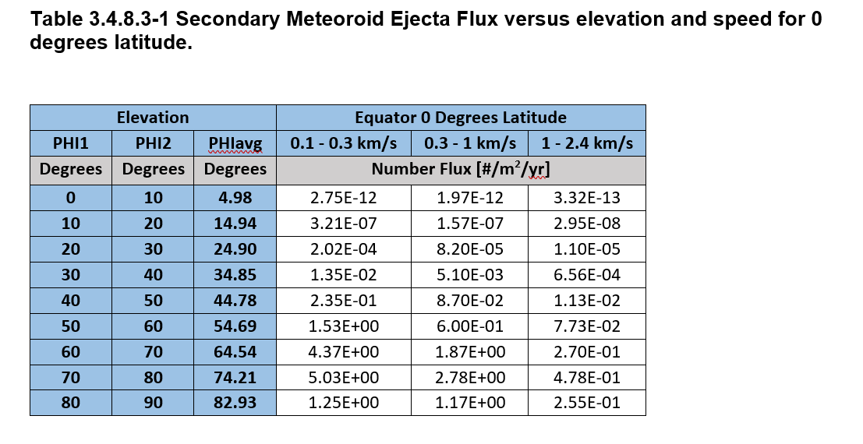
Example DSNE Table for Rev. I
The speed bins 0.1-0.3 km/s, 0.3-1 km/s, and 1-2.4 km/s were suggested by the HVIT who run Bumper for probability-of-no-penetration (PNP) risk analysis
The corresponding speed bin centers (weighted by the speed distribution and the energy) are 170 m/s, 535 m/s, and 1530 m/s.
At this point, we are assuming an isotropic azimuth ejecta environment and are only showing the impact angle dependency
SP-8013 and other models do not include angular dependency at all
The angular dependency may be important for long-term structure on the lunar surface
The HVIT has worked with us to verify correct interpretation of our environment in the Bumper code
Preliminary

Slide 5
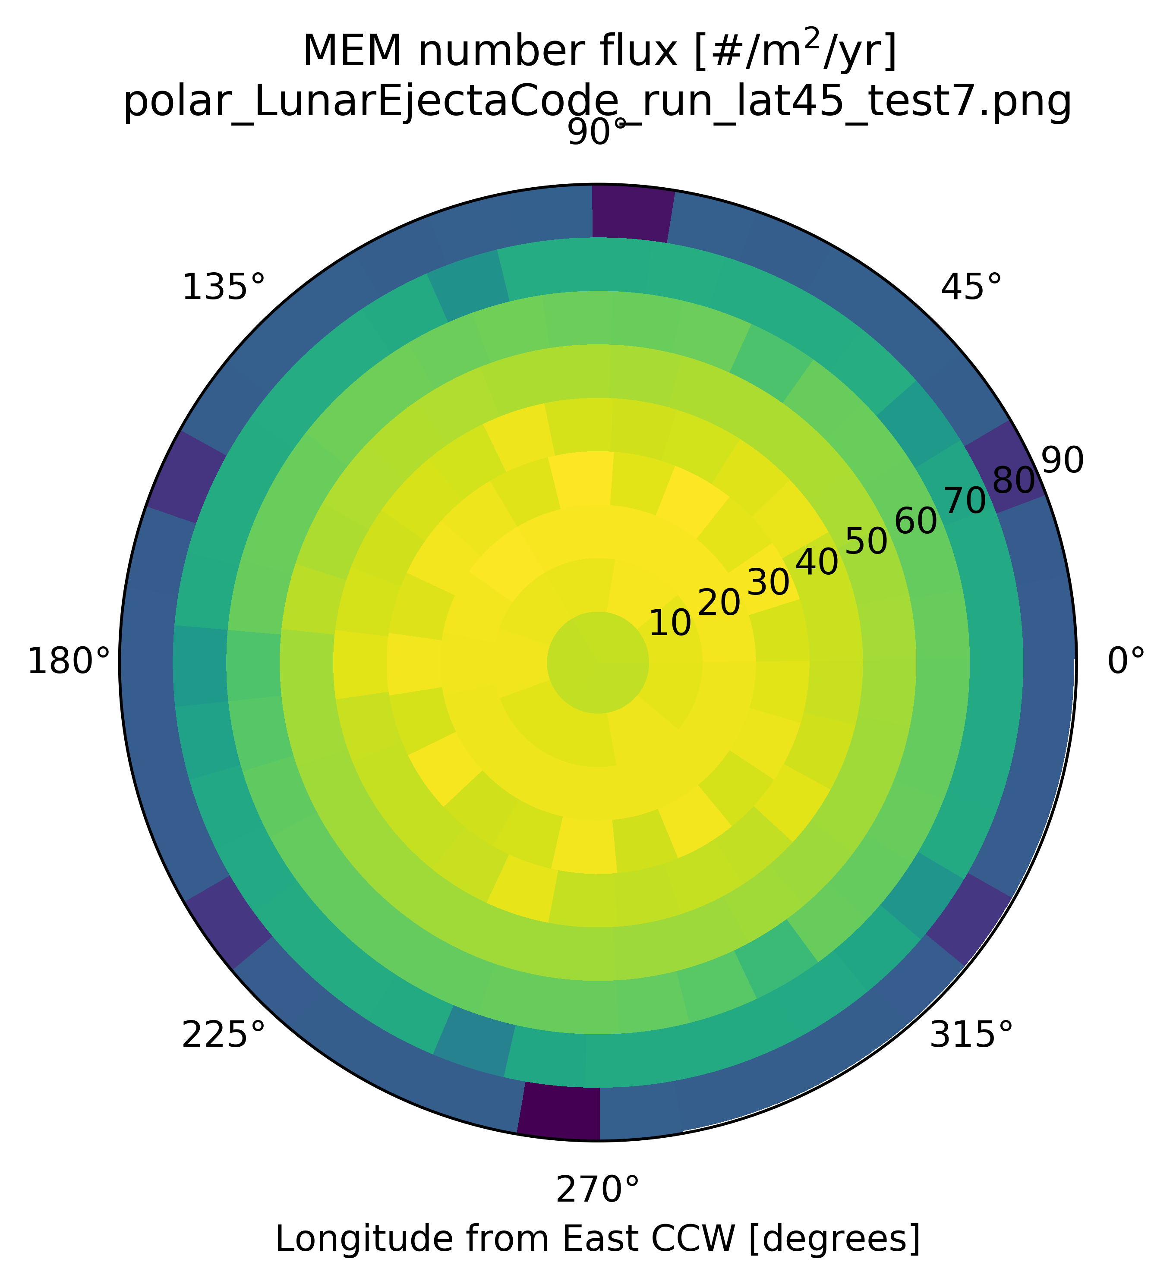
Results from the Meteoroid Model of Secondary Ejecta (MeMoSeE)
The MeMoSeE produces igloo fluxes (alt/az/speed) in the same format as MEM
External models (e.g., Bumper) that use MEM files can also use our MeMoSeE environments
The particle size distribution is assumed to be the same as the lunar regolith (Carrier 2003)
The speed distribution follows power-law scaling (Housen & Holsapple 2011) that depends implicitly on the lunar regolith properties (e.g., porosity)

Slide 6
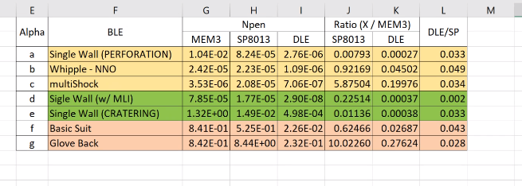
HVIT Probability of No Penetration (PNP) Comparison
Preliminary
HVIT compared the primary MEM environment (low & high density populations) with the SP-8013 and MeMoSeE (called DLE in the table) ejecta environments
Preliminary results show that MeMoSeE is:
at worst 3.6 times less risk than MEM
at worst 20.4 times less risk than SP-8013

Slide 7
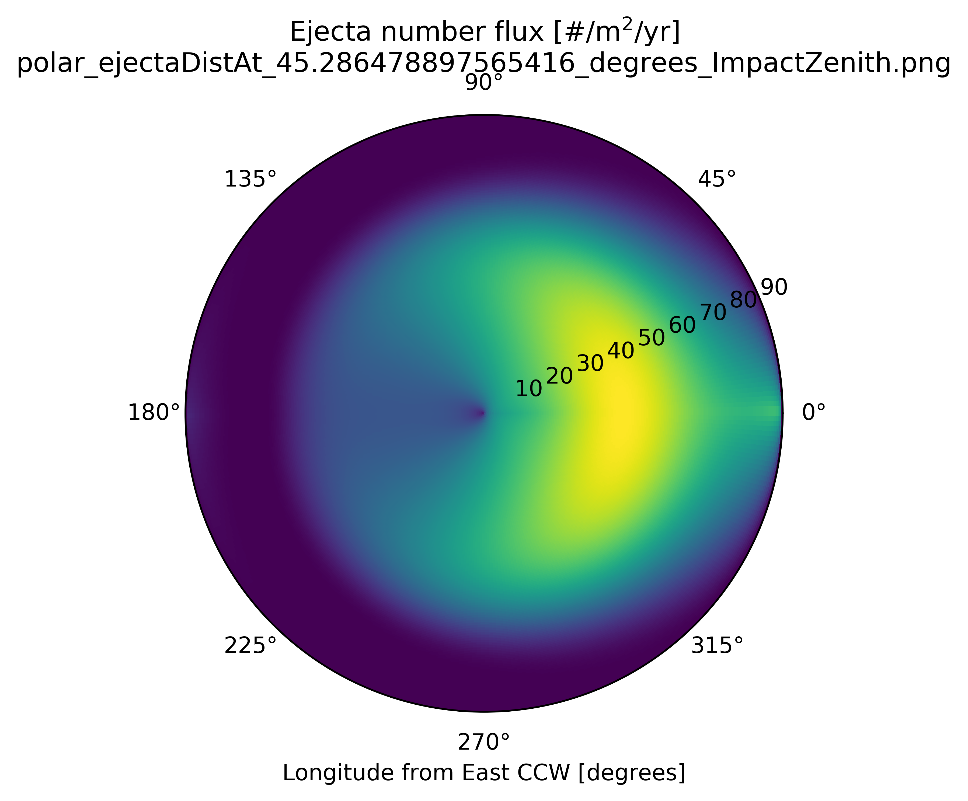
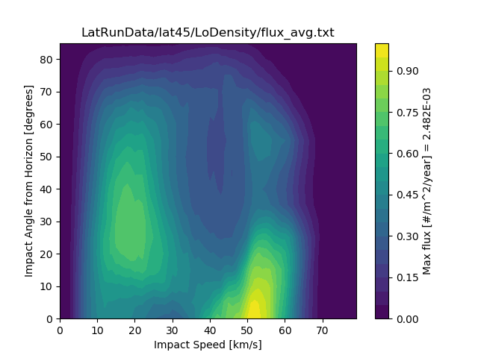
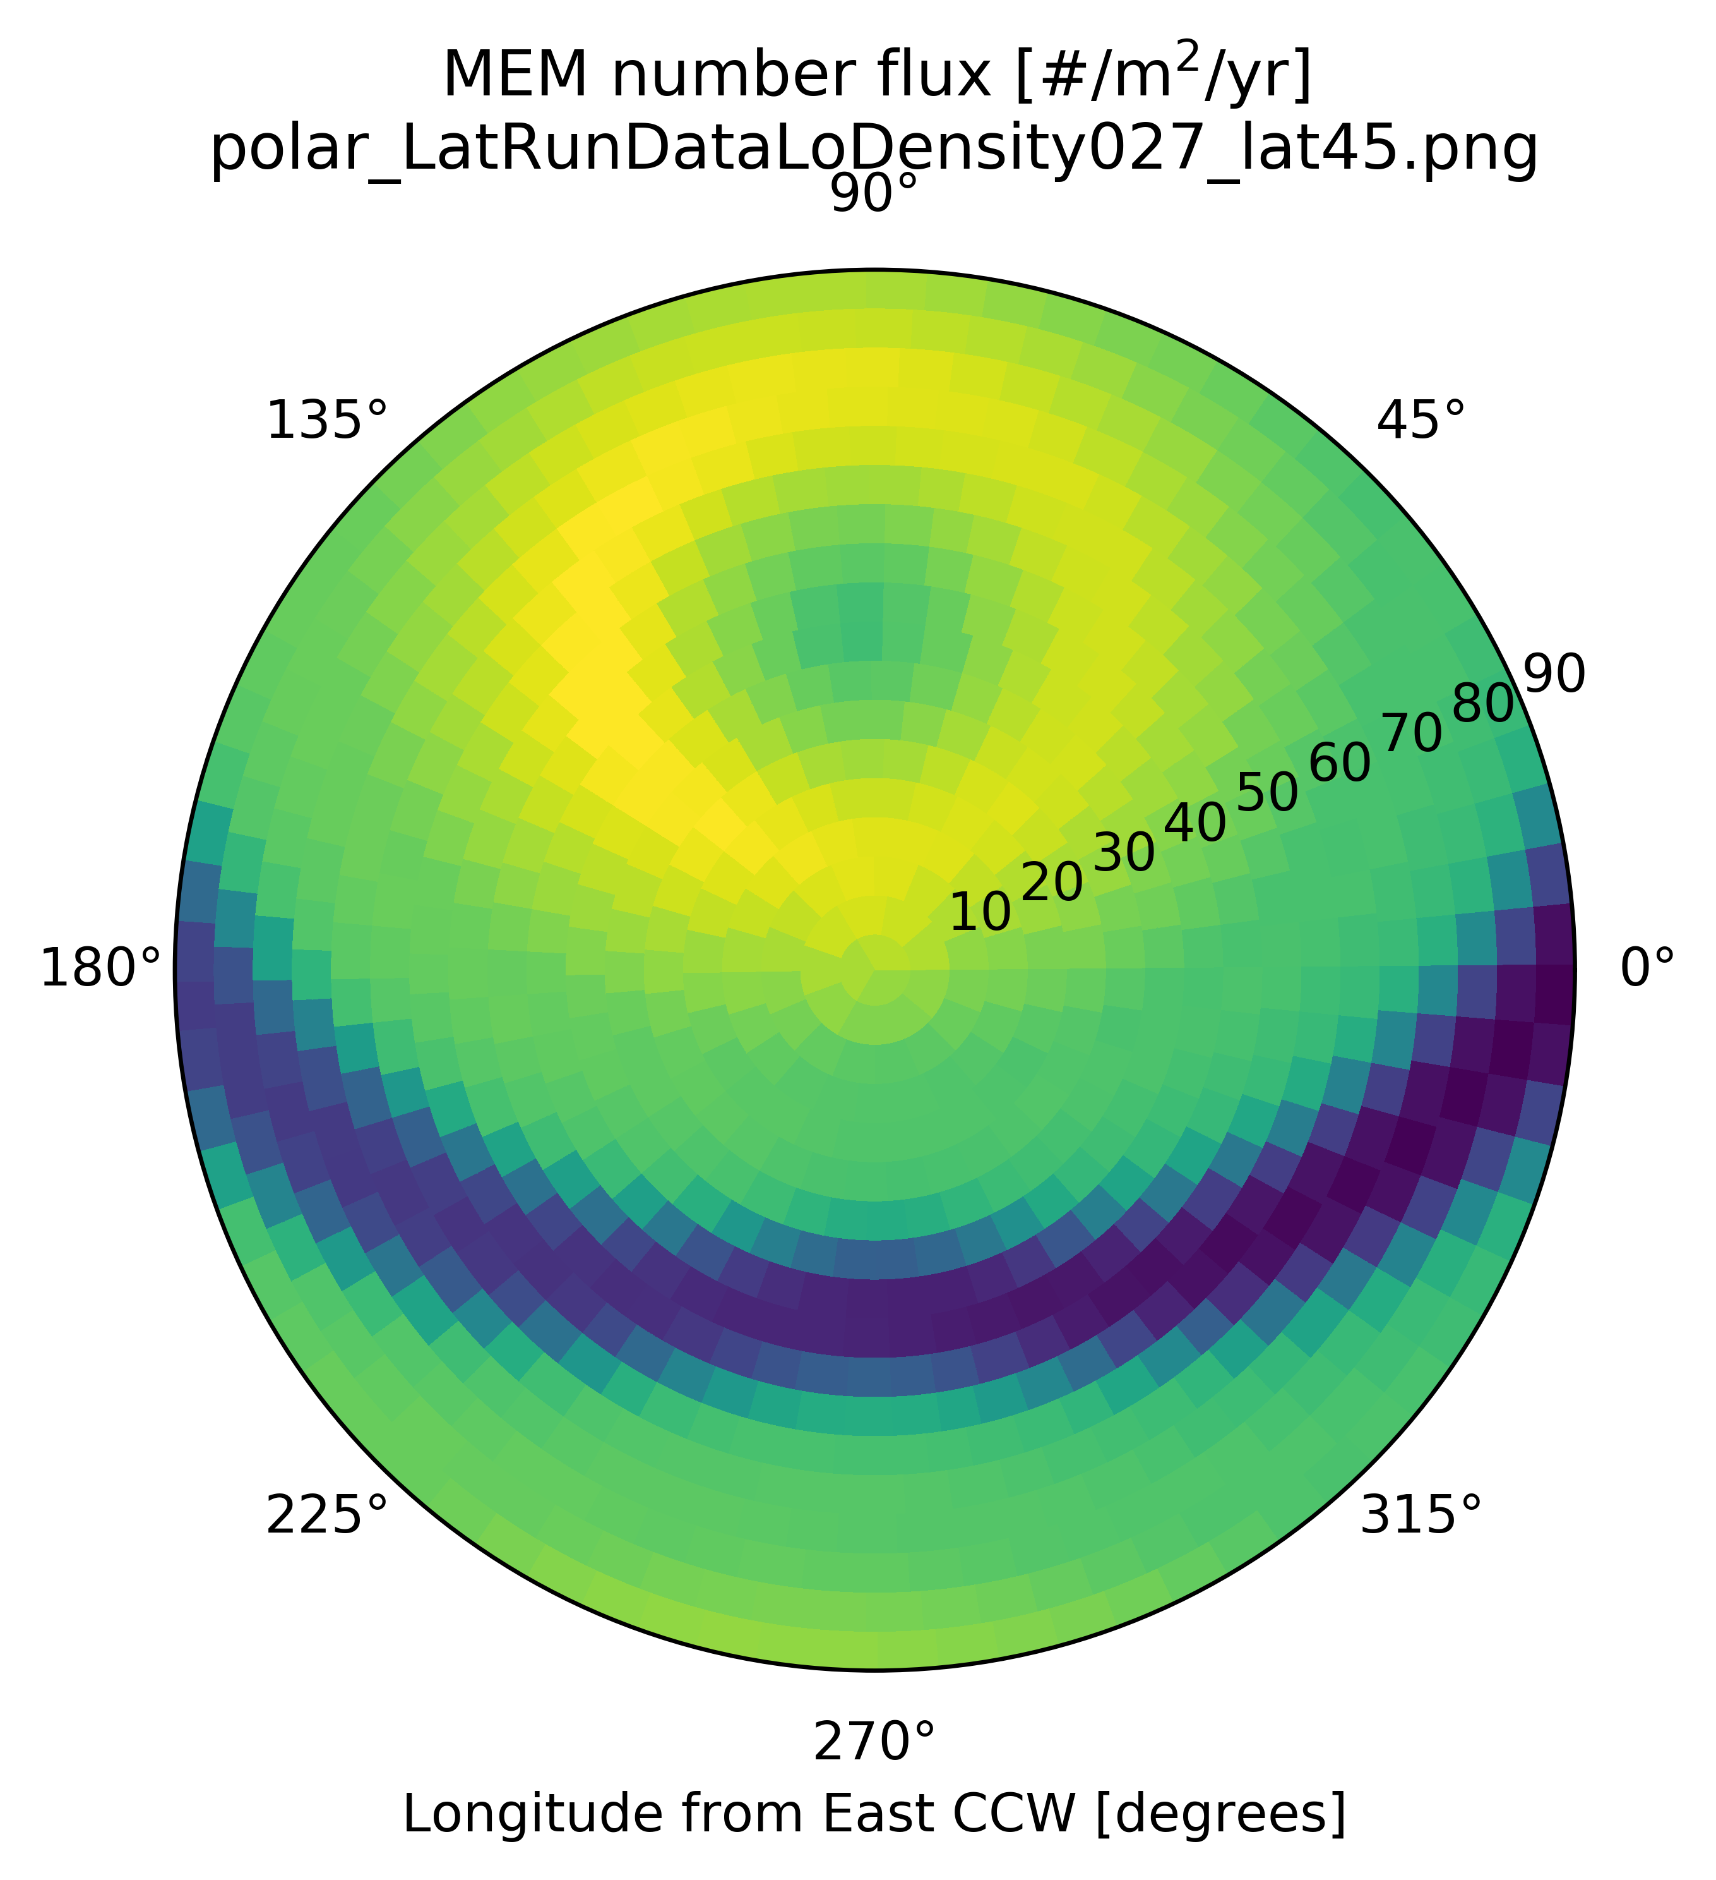

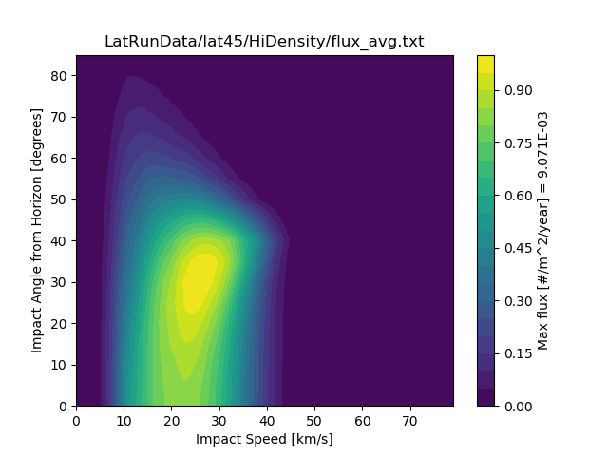
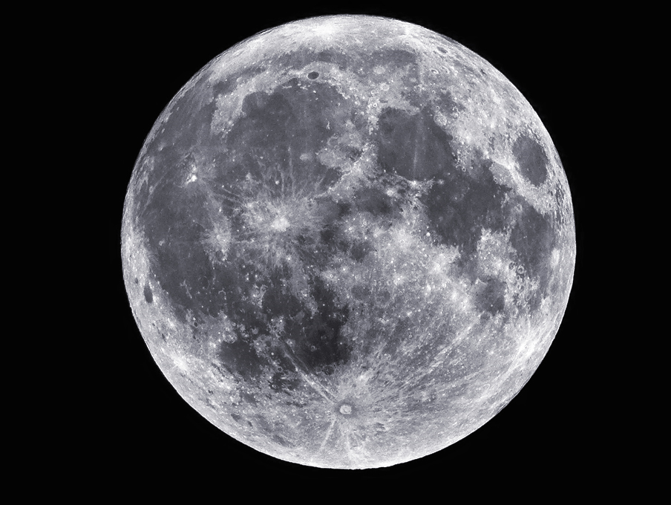

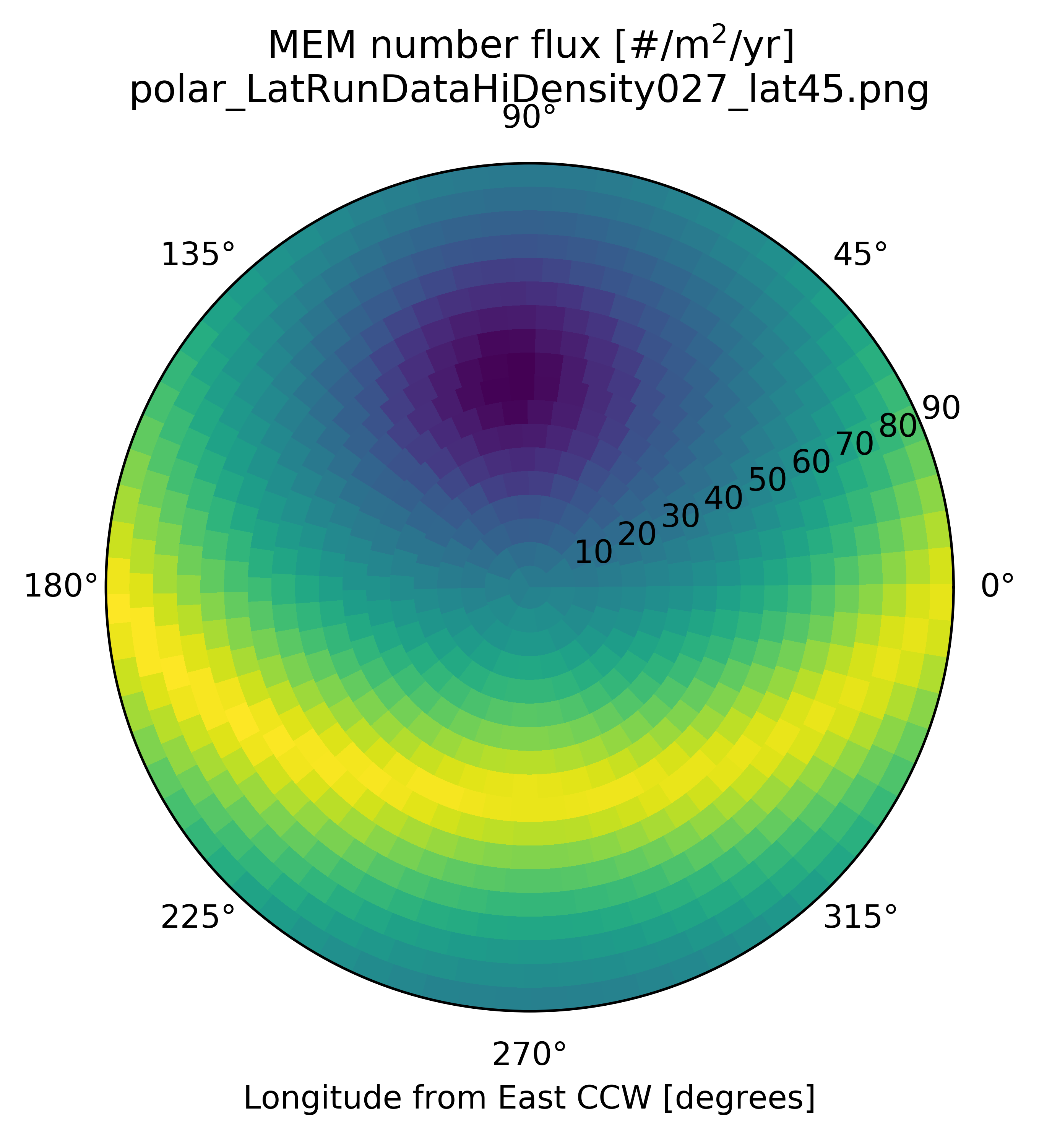
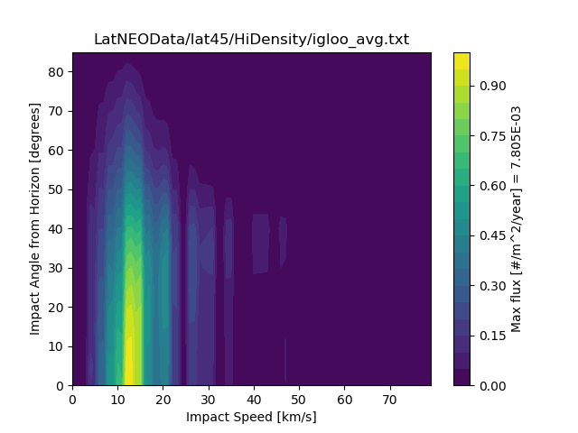





Total Ejecta Angular Distribution (at 45 degrees latitude)
Ejecta Angular Distribution (for 45 degree impact)
MEM Low Density Population
Downstream
$$α_{ejecta, ROI}$$
MEM High Density Population
$$α_{ejecta, site}$$
$$α_{impact}$$
$$φ_{ROI}$$
$$φ_{impact}$$
Near Earth Object Population

Slide 8
Forward Work
Compute NEO angular distribution from NEO orbital elements
Plans to provide lunar ejecta environment for meteor showers (only the sporadic meteors are considered in MEM)
Ability to compute lunar ejecta environment for short-term mission profiles at specific longitude/latitude locations on the Moon
If there is interest, modifications to the code could be made to compute ejecta environments for a particular orbit around the Moon (such as at Gateway)

Slide 9
Overview
Results of LuMEM
Igloo number flux distribution (based on MEM3, see Moorhead et al 2019)
Example DSNE Table for Rev. I
HVIT Probability of No Penetration (PNP) Comparison
DSNE Rev H Lunar Ejecta Model – NASA SP-8013 (1969)
Based on Zook 1967
Brief (non-exhaustive) Review of Impact-Ejecta Scaling Models
Zook 1967
Krivov et al. 2003
Housen & Holsapple 2011
Proposed New DSNE Model -- Meteoroid Model of Secondary Ejecta (MeMoSeE)
Sporadic meteoroid flux (Grun et al 1985)
Near Earth Object (NEO) flux (Brown et al 2002)
Impact-ejecta scaling model (Housen & Holsapple 2011)
Ejecta particle size distribution (Carrier 2003)
Ejecta zenith angle distribution (empirically from Gault & Wedekind 1978)
Ejecta azimuth angle distribution (modified from Rival & Mandeville 1999)
Analytic model of lunar ejecta
Speed distribution as a function of distance
Secondary flux as a function of distance
Secondary flux in terms of primary flux

Slide 10
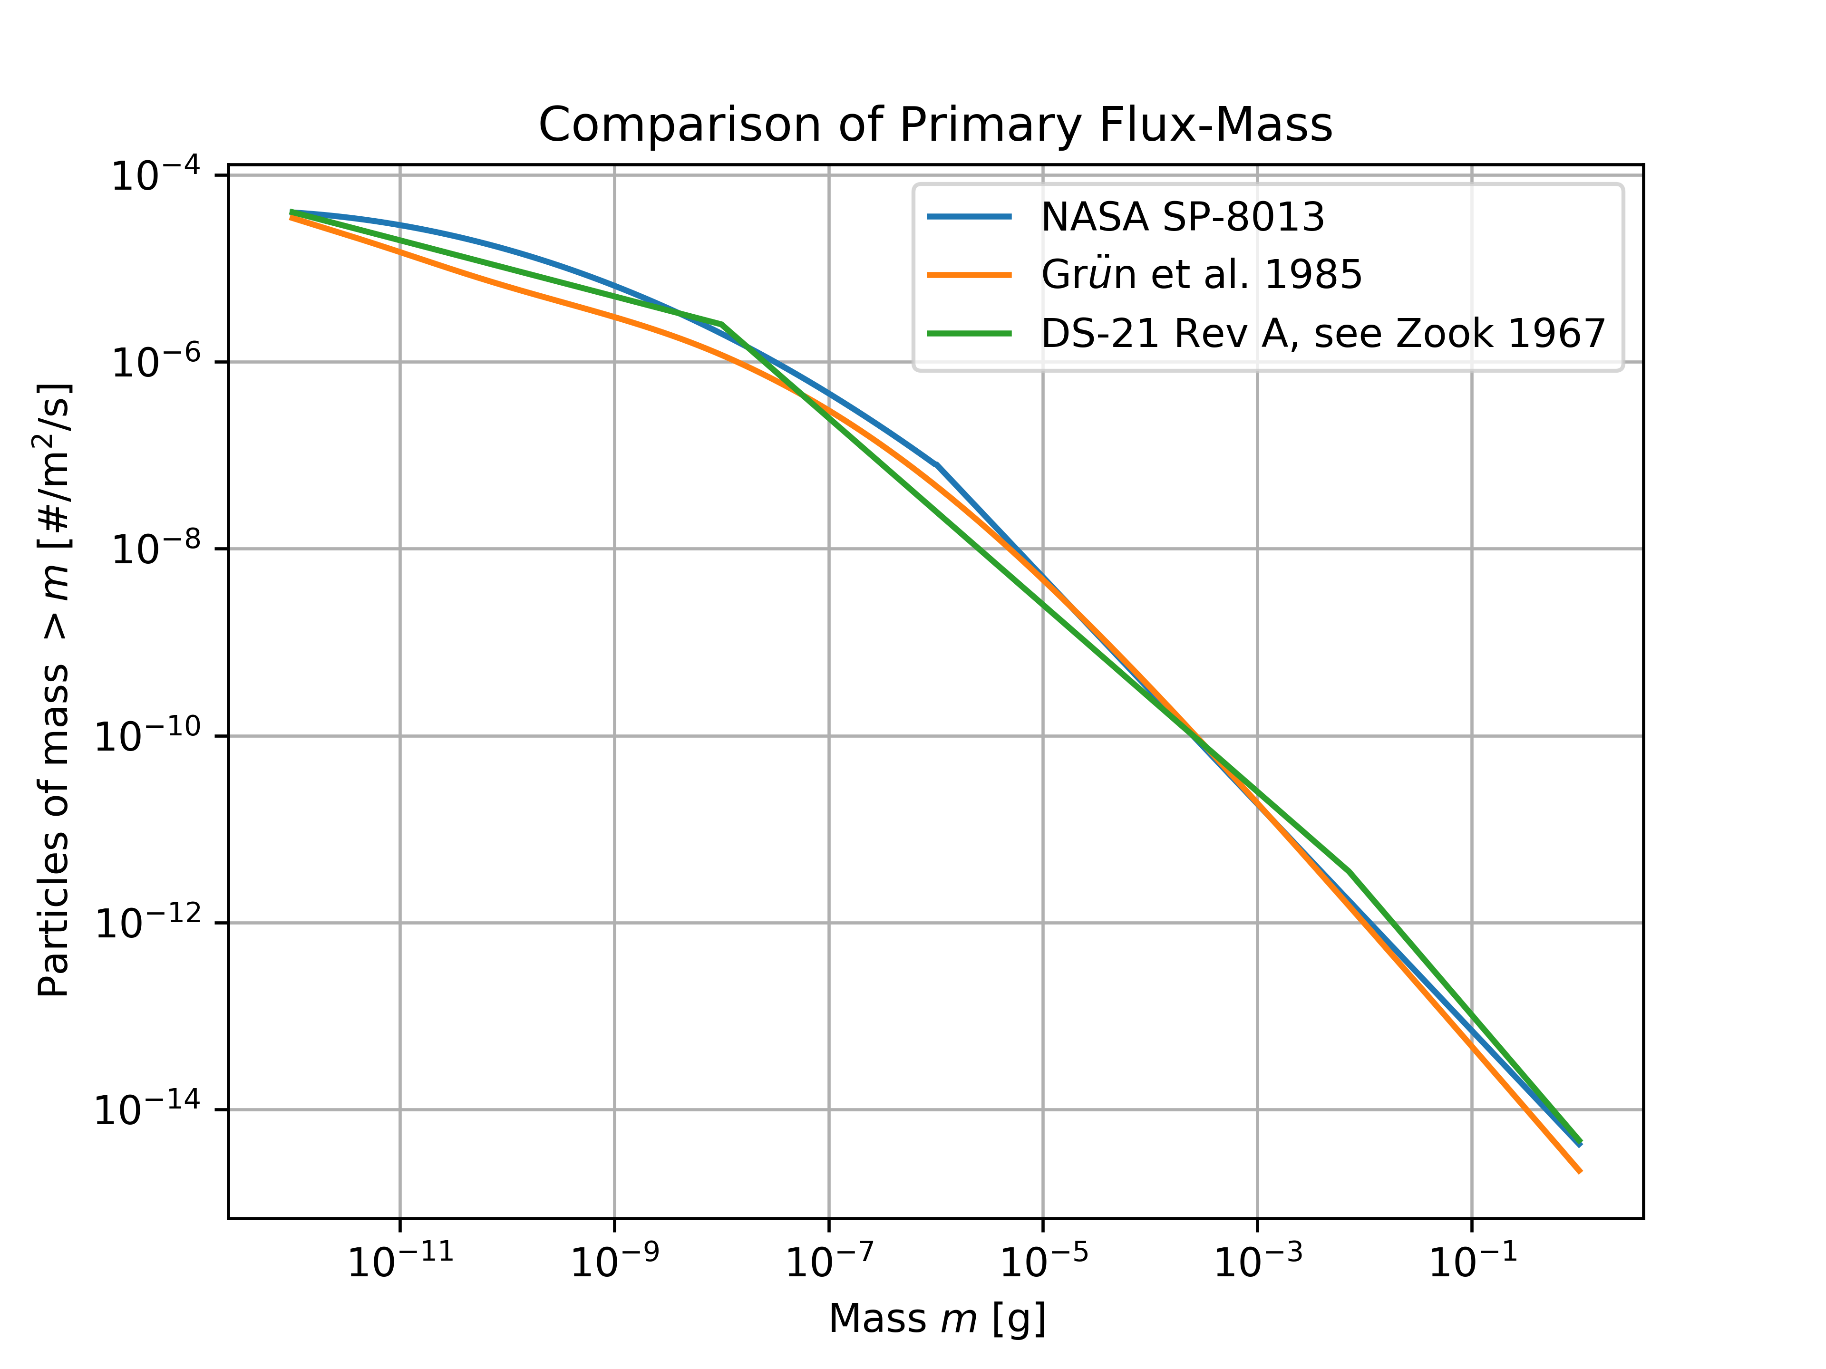
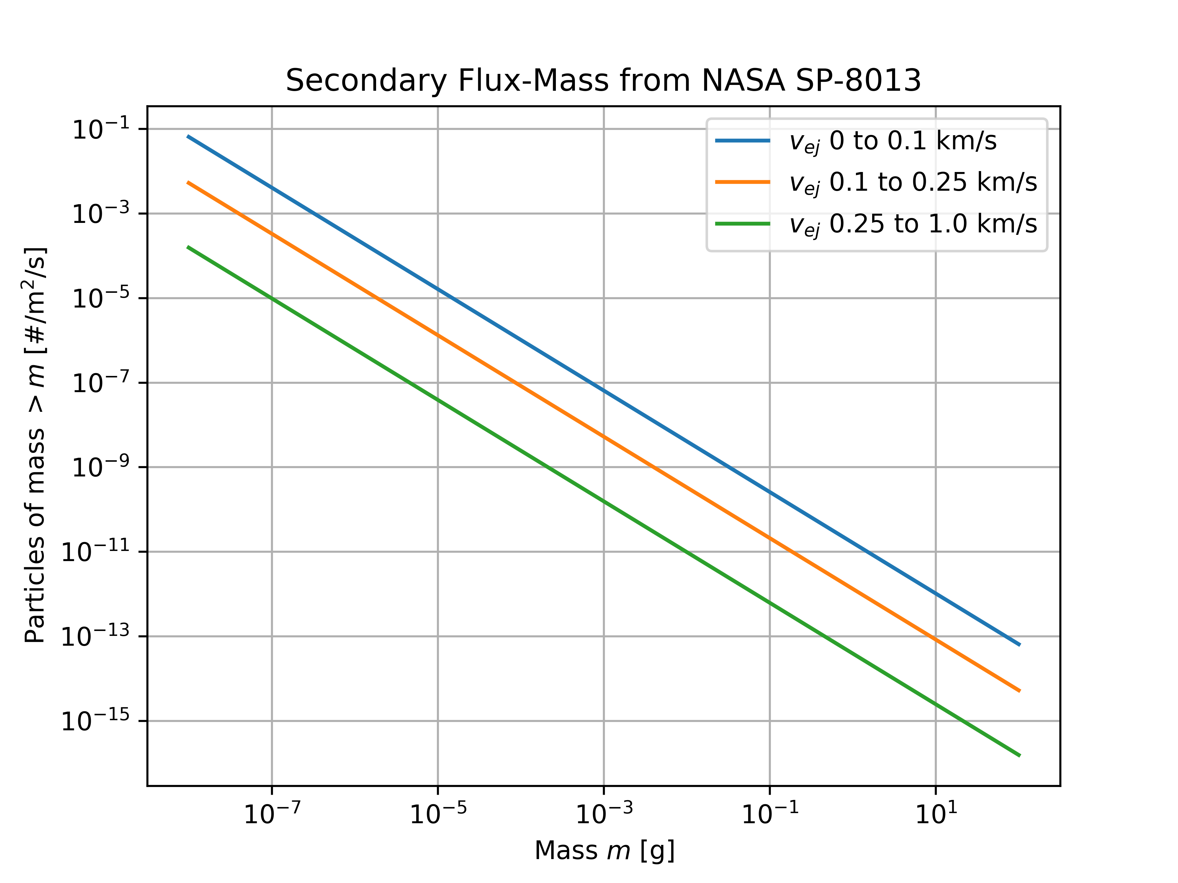
DSNE Rev H Lunar Ejecta Model NASA SP-8013 (1969)
Average speed [both] = 20 km/s
Density [NASA SP-8013] = 0.5 g/cm^3
Density [Grun et al 1985] = 2.5 g/cm^3
Density = 2.5 g/cm^3

Slide 11
Overview
Results of LuMEM
Igloo number flux distribution (based on MEM3, see Moorhead et al 2019)
Example DSNE Table for Rev. I
HVIT Probability of No Penetration (PNP) Comparison
DSNE Rev H Lunar Ejecta Model – NASA SP-8013 (1969)
Based on Zook 1967
Brief (non-exhaustive) Review of Impact-Ejecta Scaling Models
Zook 1967
Krivov et al. 2003
Housen & Holsapple 2011
Proposed New DSNE Model -- Meteoroid Model of Secondary Ejecta (MeMoSeE)
Sporadic meteoroid flux (Grun et al 1985)
Near Earth Object (NEO) flux (Brown et al 2002)
Impact-ejecta scaling model (Housen & Holsapple 2011)
Ejecta particle size distribution (Carrier 2003)
Ejecta zenith angle distribution (empirically from Gault & Wedekind 1978)
Ejecta azimuth angle distribution (modified from Rival & Mandeville 1999)
Analytic model of lunar ejecta
Speed distribution as a function of distance
Secondary flux as a function of distance
Secondary flux in terms of primary flux

Slide 12
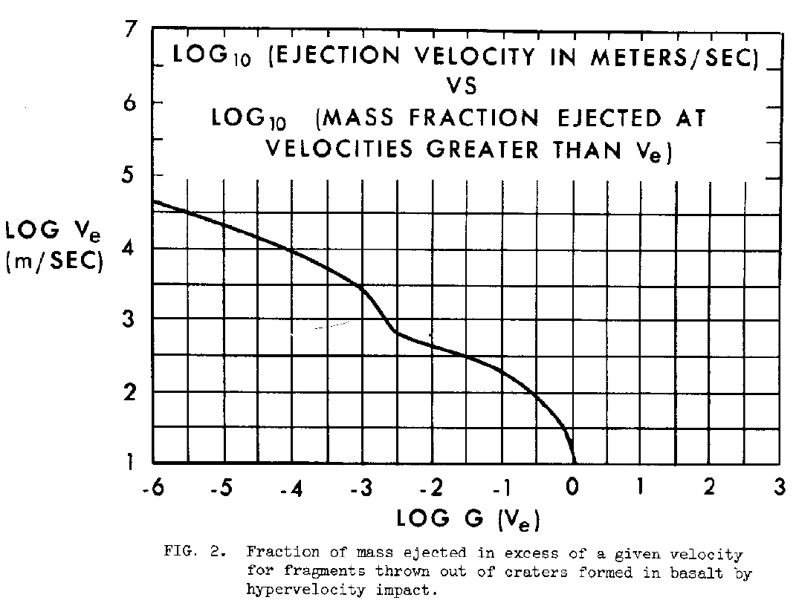
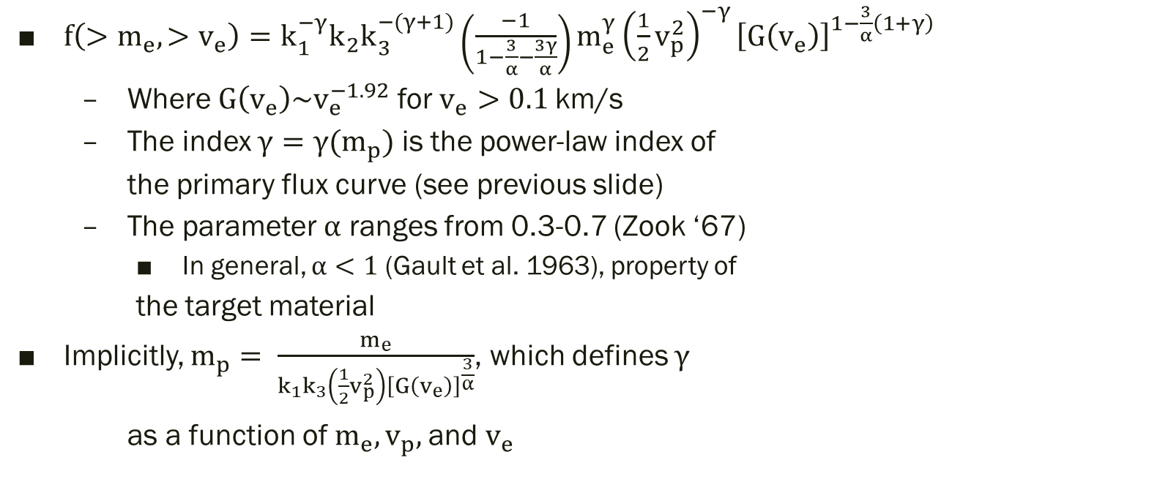
Impact-Ejecta Scaling Models Zook 1967
$f\left(>m_{e}, >v_{e}\right)=k_{1}^{−γ}k_{2}k_{3}^{−(γ+1)}\left(\frac{−1}{1−\frac{3}{α}−\frac{3γ}{α}}\right)m_{e}^{γ}{\left(\frac{1}{2}v_{p}^{2}\right)}^{−γ}{\left[G\left(v_{e}\right)\right]}^{1−\frac{3}{α}\left(1+γ\right)}$
Where $G\left(v_{e}\right)\sim v_{e}^{−1.92}$ for $v_{e}>0.1$km/s
The index $γ=γ(m_{p})$ is the power-law index of
the primary flux curve (see previous slide)
The parameter $α$ ranges from 0.3-0.7 (Zook ‘67)
In general, $α<1$ (Gault et al. 1963), property of
the target material
Implicitly, $m_{p}= \frac{m_{e}}{k_{1}k_{3}\left(\frac{1}{2}v_{p}^{2}\right){\left[G\left(v_{e}\right)\right]}^{\frac{3}{α}}}$, which defines $γ$
as a function of $m_{e}, v_{p},$and $v_{e}$

Slide 13
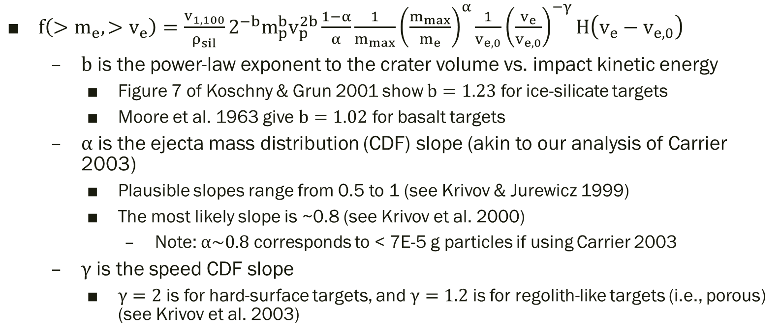
Impact-Ejecta Scaling Models Krivov et al. 2003
$f\left(>m_{e}, >v_{e}\right)=\frac{v_{1,100}}{ρ_{sil}}2^{−b}m_{p}^{b}v_{p}^{2b}\frac{1−α}{α}\frac{1}{m_{max}}{\left(\frac{m_{max}}{m_{e}}\right)}^{α}\frac{1}{v_{e,0}}{\left(\frac{v_{e}}{v_{e,0}}\right)}^{−γ}H\left(v_{e}−v_{e,0}\right)$
$b$ is the power-law exponent to the crater volume vs. impact kinetic energy
Figure 7 of Koschny & Grun 2001 show $b=1.23$ for ice-silicate targets
Moore et al. 1963 give $b=1.02$ for basalt targets
$α$ is the ejecta mass distribution (CDF) slope (akin to our analysis of Carrier 2003)
Plausible slopes range from 0.5 to 1 (see Krivov & Jurewicz 1999)
The most likely slope is ~0.8 (see Krivov et al. 2000)
Note: $α\sim 0.8$ corresponds to < 7E-5 g particles if using Carrier 2003
$γ$ is the speed CDF slope
$γ=2$ is for hard-surface targets, and $γ=1.2$ is for regolith-like targets (i.e., porous) (see Krivov et al. 2003)

Slide 14
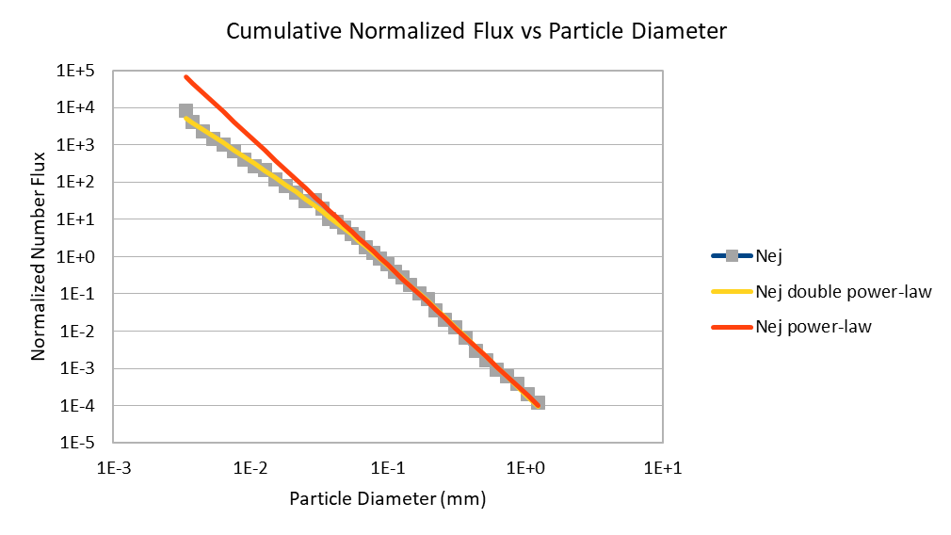
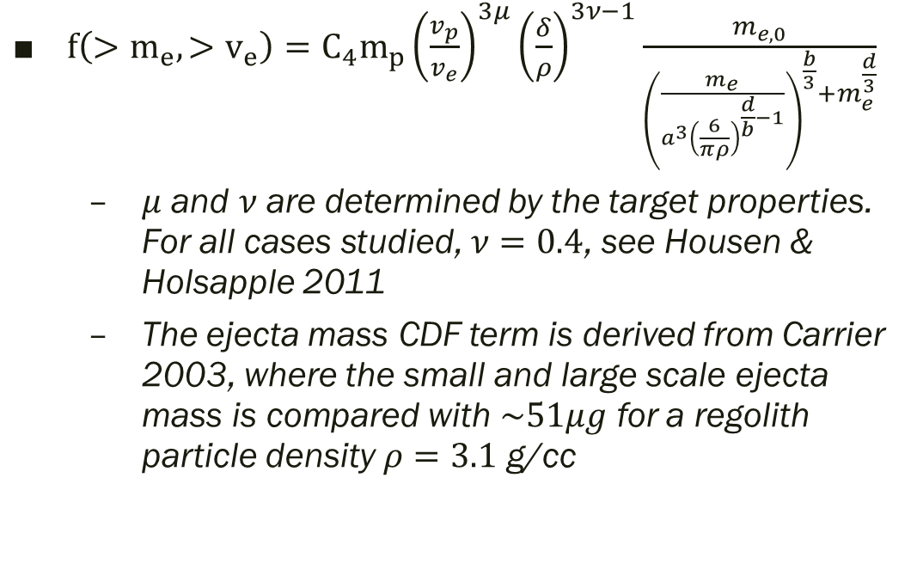
Impact-Ejecta Scaling Models Housen & Holsapple 2011
$f\left(>m_{e}, >v_{e}\right)=C_{4}m_{p}{\left(\frac{v_{p}}{v_{e}}\right)}^{3μ}{\left(\frac{δ}{ρ}\right)}^{3ν−1}\frac{m_{e,0}}{{\left(\frac{m_{e}}{a^{3}{\left(\frac{6}{πρ}\right)}^{\frac{d}{b}−1}}\right)}^{\frac{b}{3}}+m_{e}^{\frac{d}{3}}}$
$μ$ and $ν$ are determined by the target properties. For all cases studied, $ν=0.4$, see Housen & Holsapple 2011
The ejecta mass CDF term is derived from Carrier 2003, where the small and large scale ejecta mass is compared with $\sim 51μg$ for a regolith particle density $ρ=3.1$ g/cc

Slide 15
Overview
Results of LuMEM
Igloo number flux distribution (based on MEM3, see Moorhead et al 2019)
Example DSNE Table for Rev. I
HVIT Probability of No Penetration (PNP) Comparison
DSNE Rev H Lunar Ejecta Model – NASA SP-8013 (1969)
Based on Zook 1967
Brief (non-exhaustive) Review of Impact-Ejecta Scaling Models
Zook 1967
Krivov et al. 2003
Housen & Holsapple 2011
Proposed New DSNE Model -- Meteoroid Model of Secondary Ejecta (MeMoSeE)
Sporadic meteoroid flux (Grun et al 1985)
Near Earth Object (NEO) flux (Brown et al 2002)
Impact-ejecta scaling model (Housen & Holsapple 2011)
Ejecta particle size distribution (Carrier 2003)
Ejecta zenith angle distribution (empirically from Gault & Wedekind 1978)
Ejecta azimuth angle distribution (modified from Rival & Mandeville 1999)
Analytic model of lunar ejecta
Speed distribution as a function of distance
Secondary flux as a function of distance
Secondary flux in terms of primary flux

Slide 16
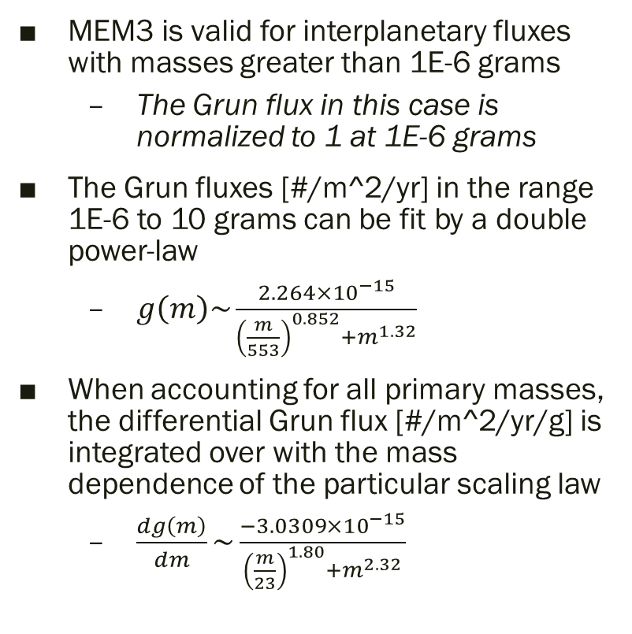
Sporadic meteoroid flux (Grun et al. 1985)
MEM3 is valid for interplanetary fluxes with masses greater than 1E-6 grams
The Grun flux in this case is normalized to 1 at 1E-6 grams
The Grun fluxes [#/m^2/yr] in the range 1E-6 to 10 grams can be fit by a double power-law
$g\left(m\right)\sim \frac{2.264×{10}^{−15}}{{\left(\frac{m}{553}\right)}^{0.852}+m^{1.32}}$
When accounting for all primary masses, the differential Grun flux [#/m^2/yr/g] is integrated over with the mass dependence of the particular scaling law
$\frac{dg\left(m\right)}{dm}\sim \frac{−3.0309×{10}^{−15}}{{\left(\frac{m}{23}\right)}^{1.80}+m^{2.32}}$

Slide 17
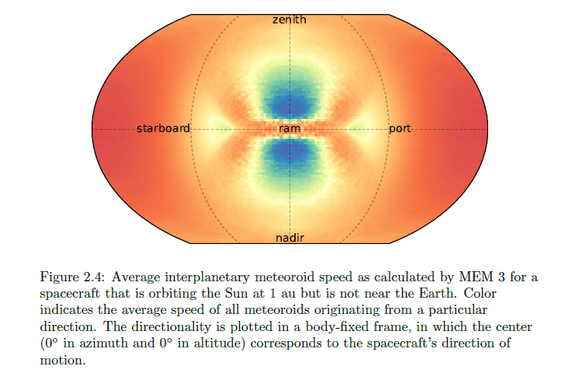
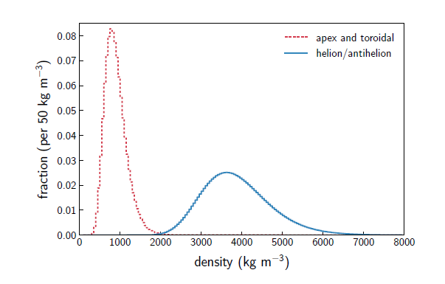
Sporadic meteoroid flux (low and high density populations in MEM)
Apex & toroidal
Helion/antihelion
Log-normal distributions
Moorhead 2019

Slide 18
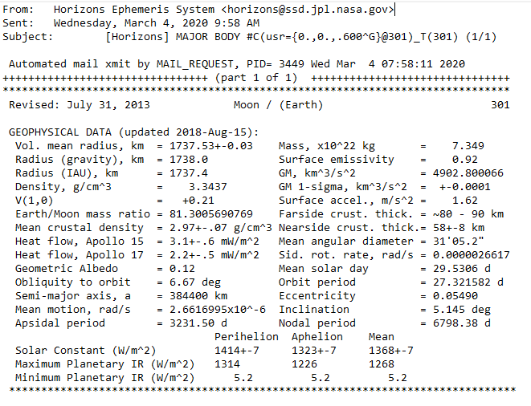

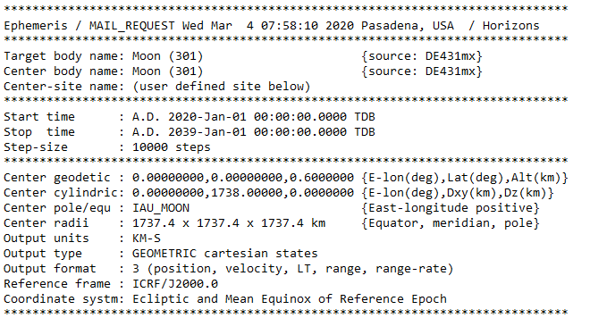
Lunar Surface Ephemeris for MEM – JPL Horizons
A total of 37 ephemeris files generated for a fixed location on the Moon
19-year (Metonic cycle) time period of trajectory
5 degree latitude intervals from south pole to north pole
0 degrees longitude (central meridian)
Timestep ~ 16 hours 40 minutes (10,000 total)

Slide 19
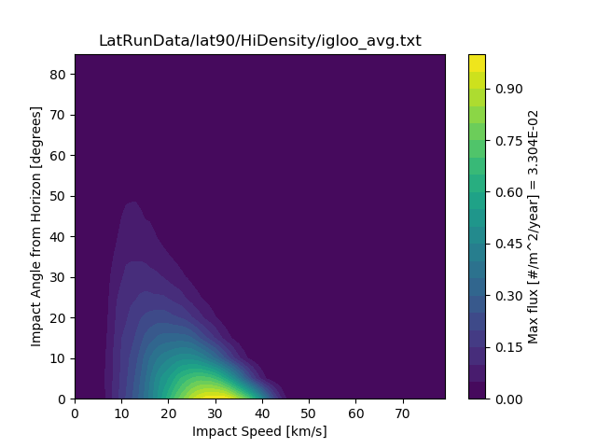
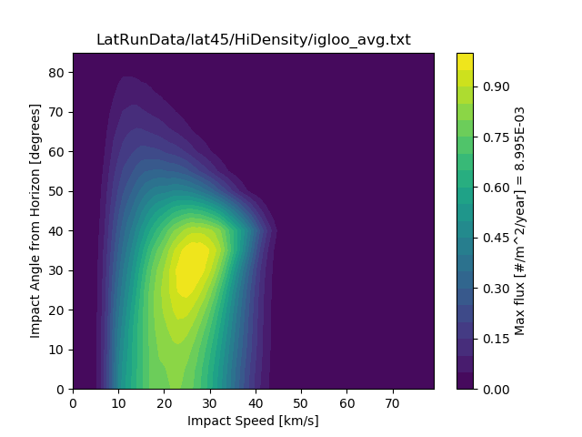
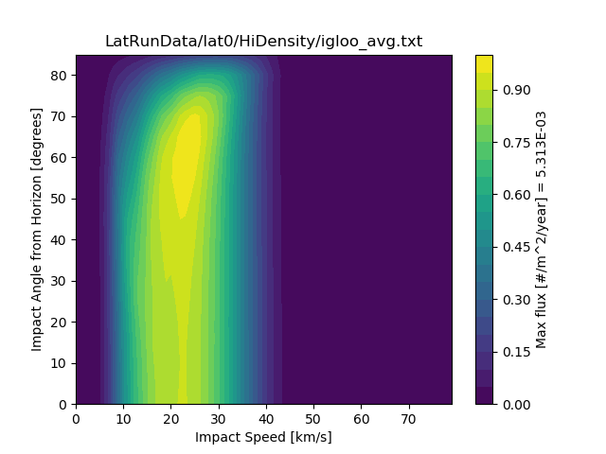
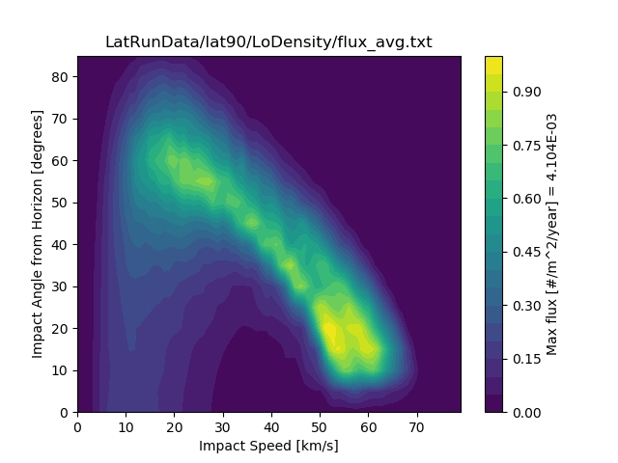
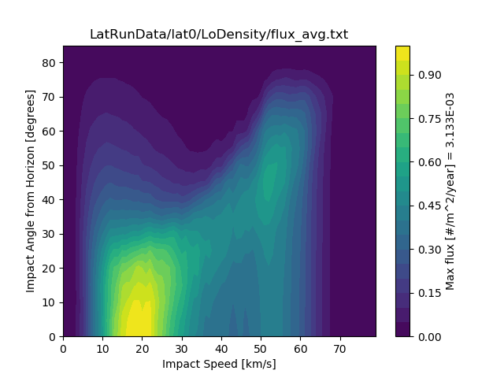
Sporadic meteoroid flux (angle/speed) and latitudinal dependence on the lunar surface

Slide 20
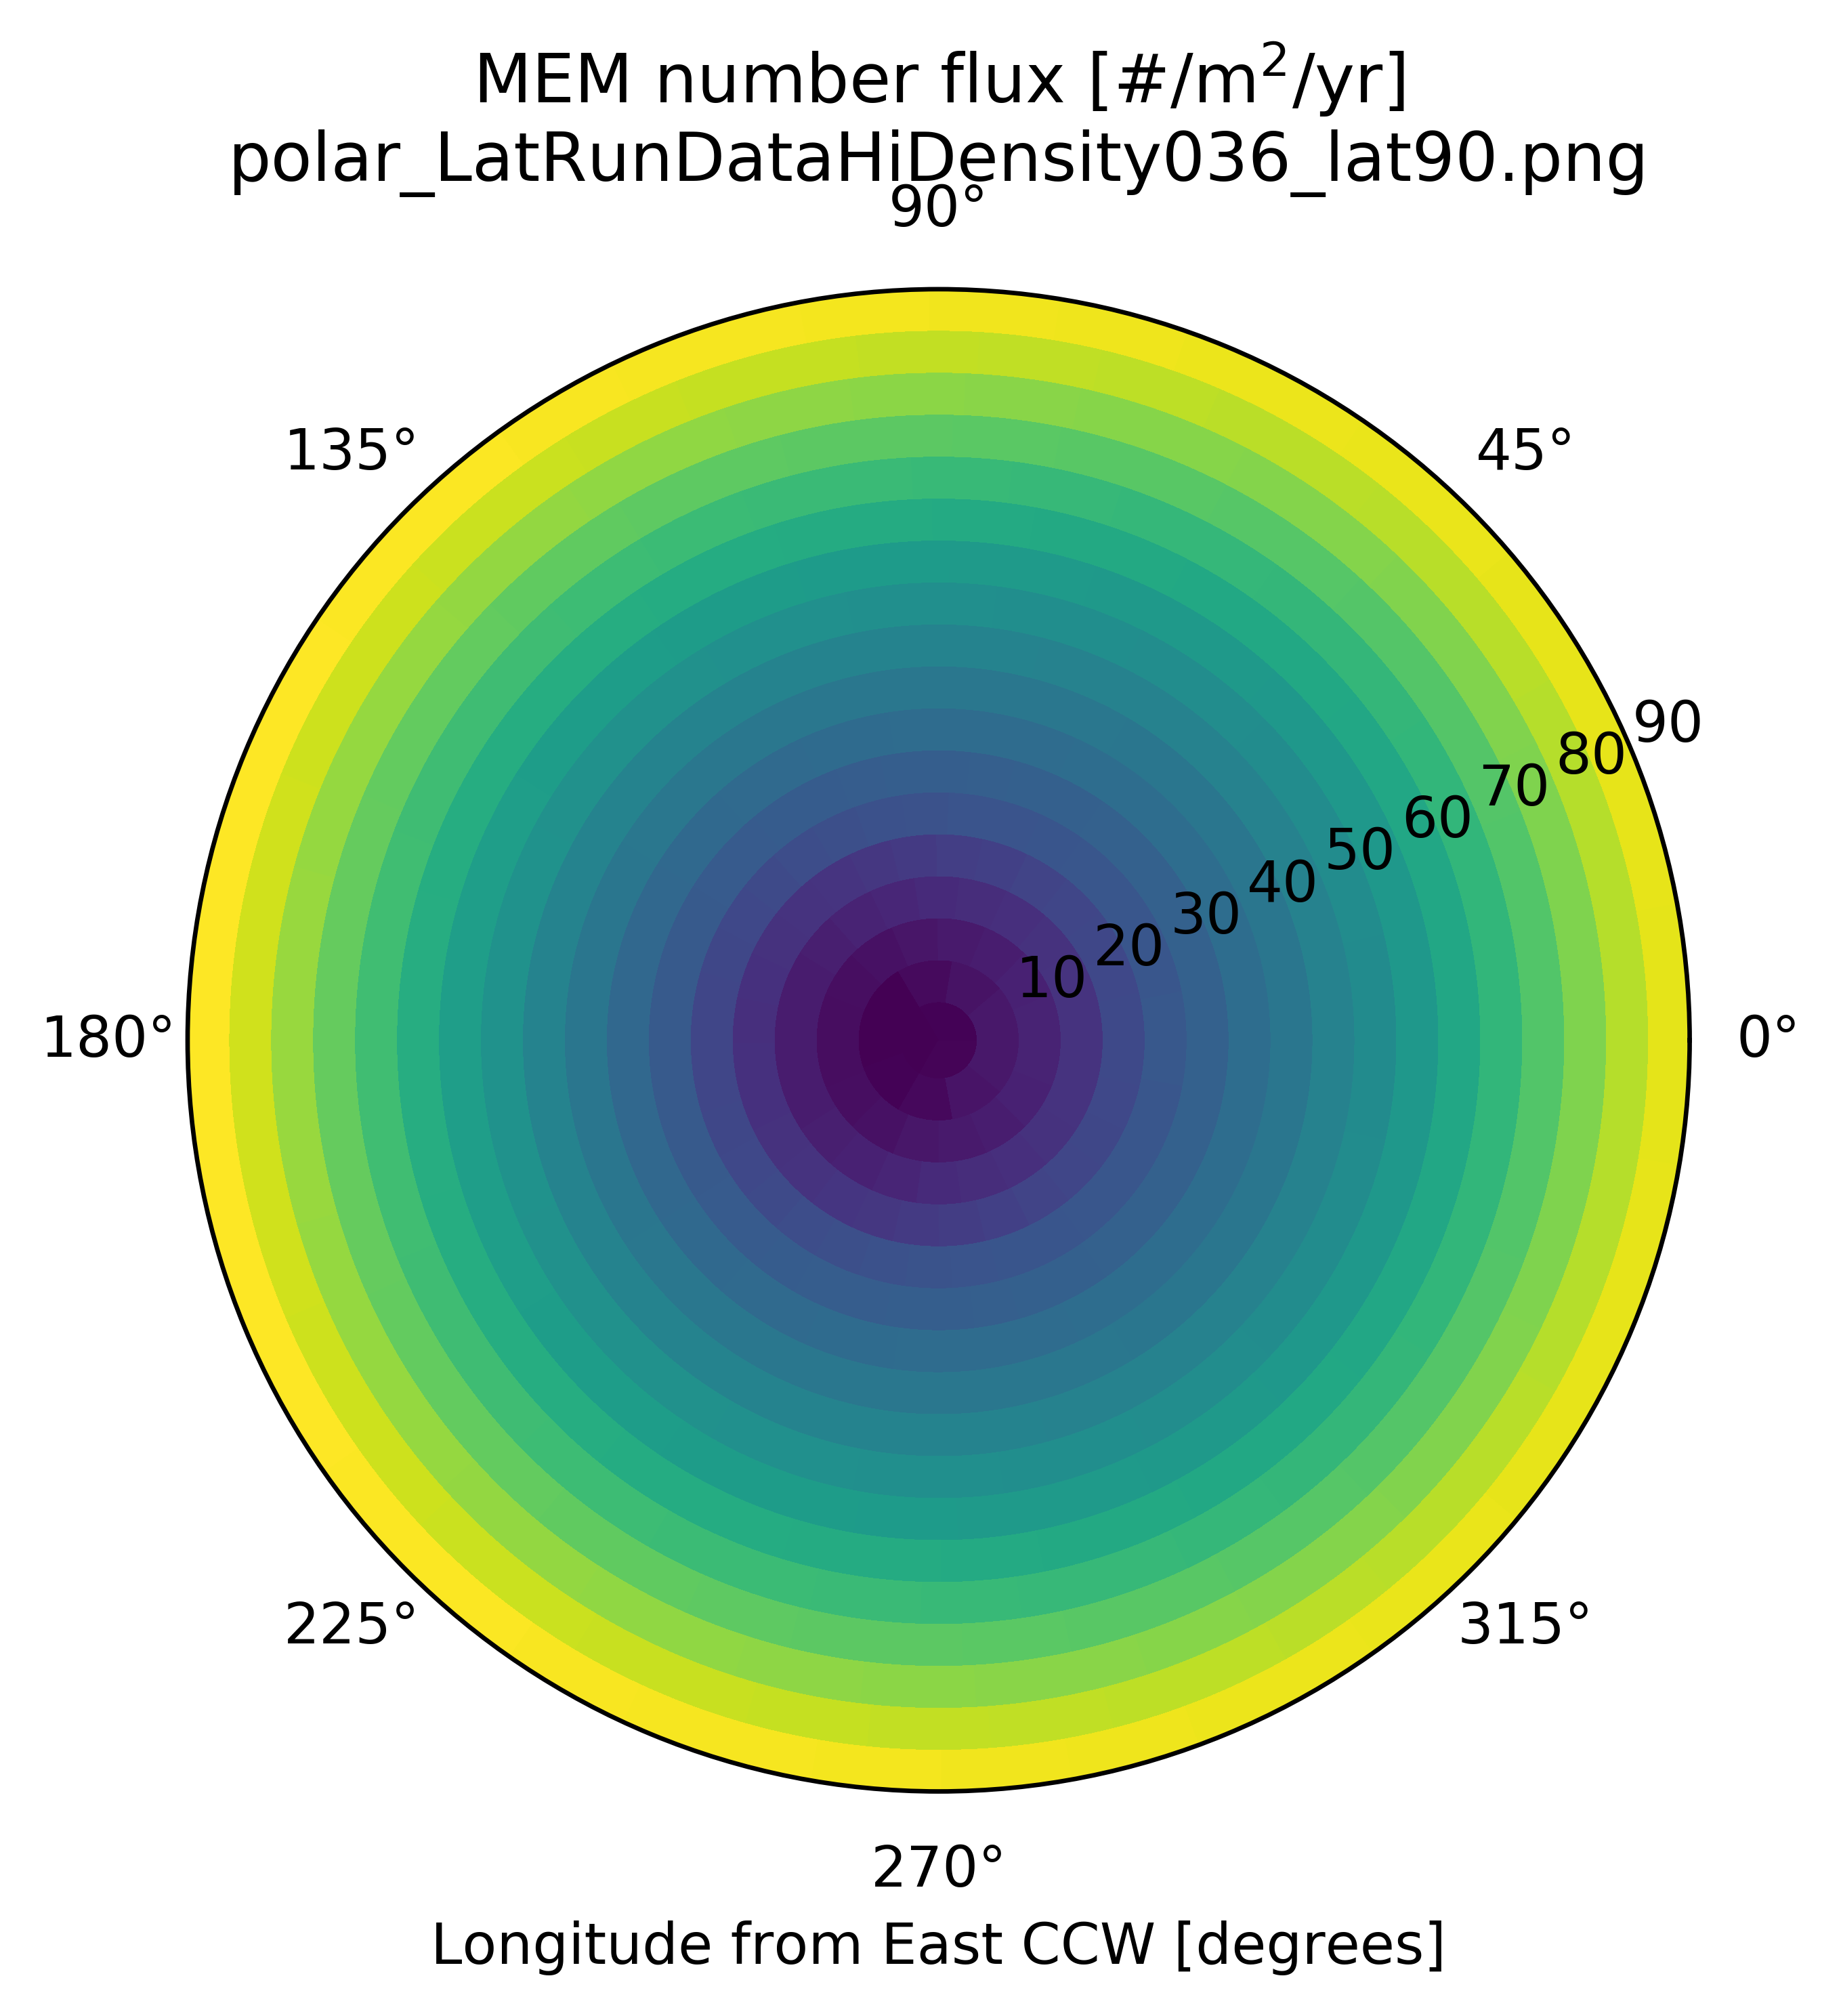
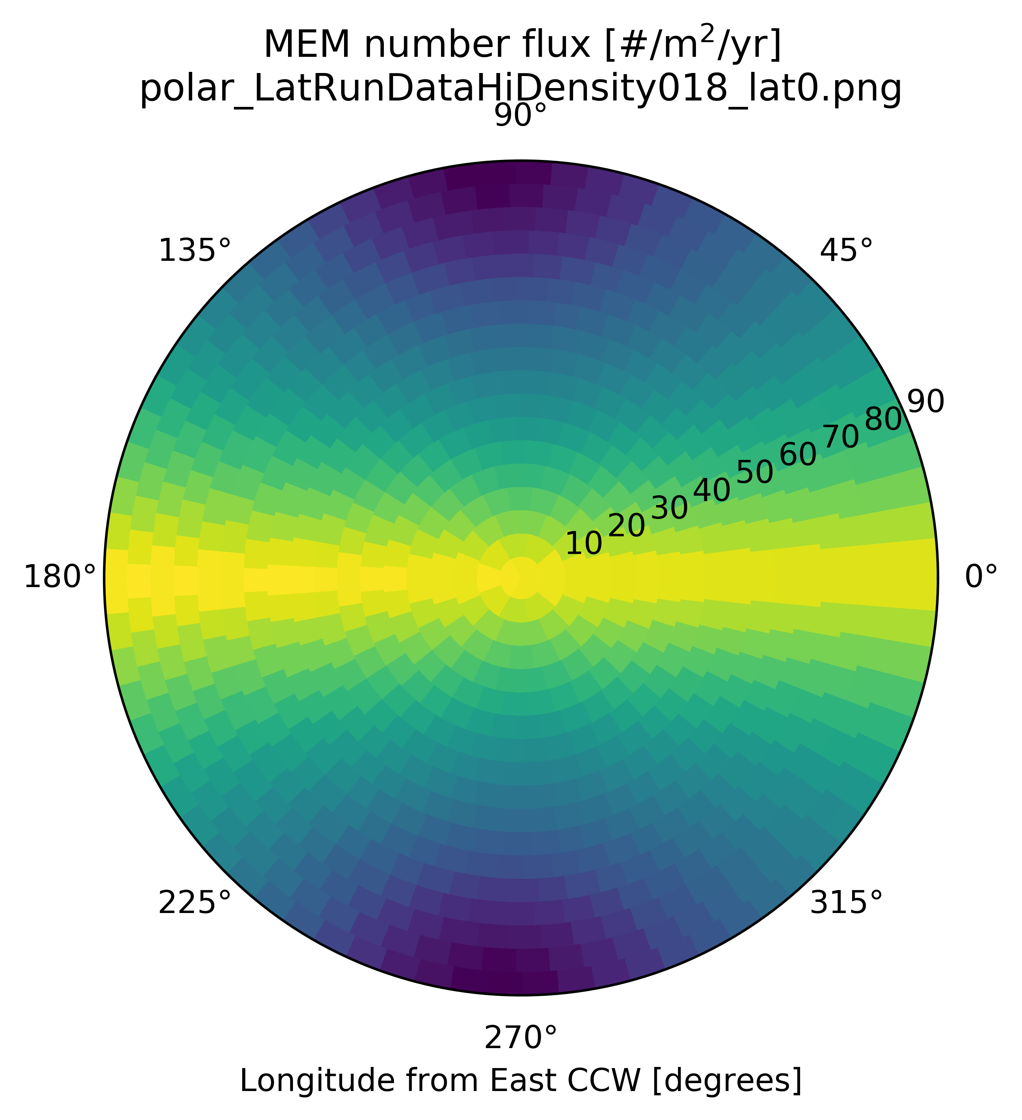
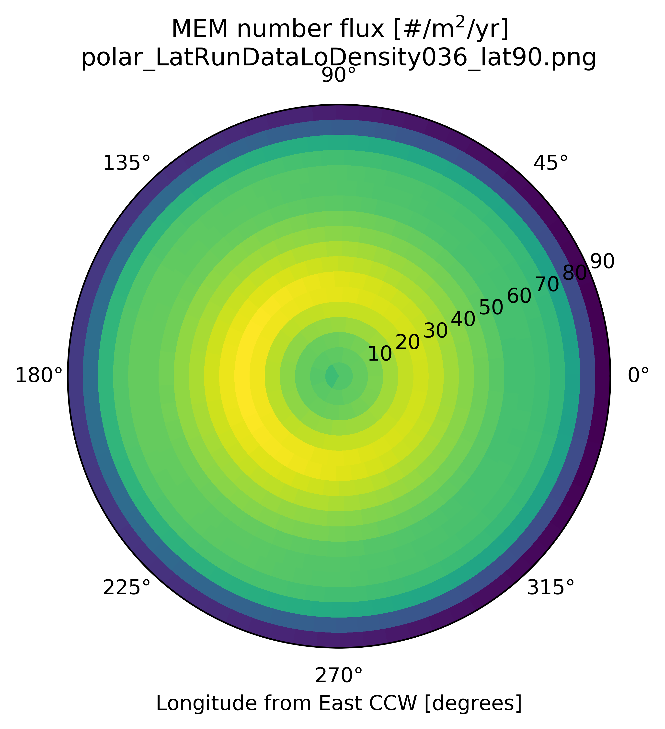
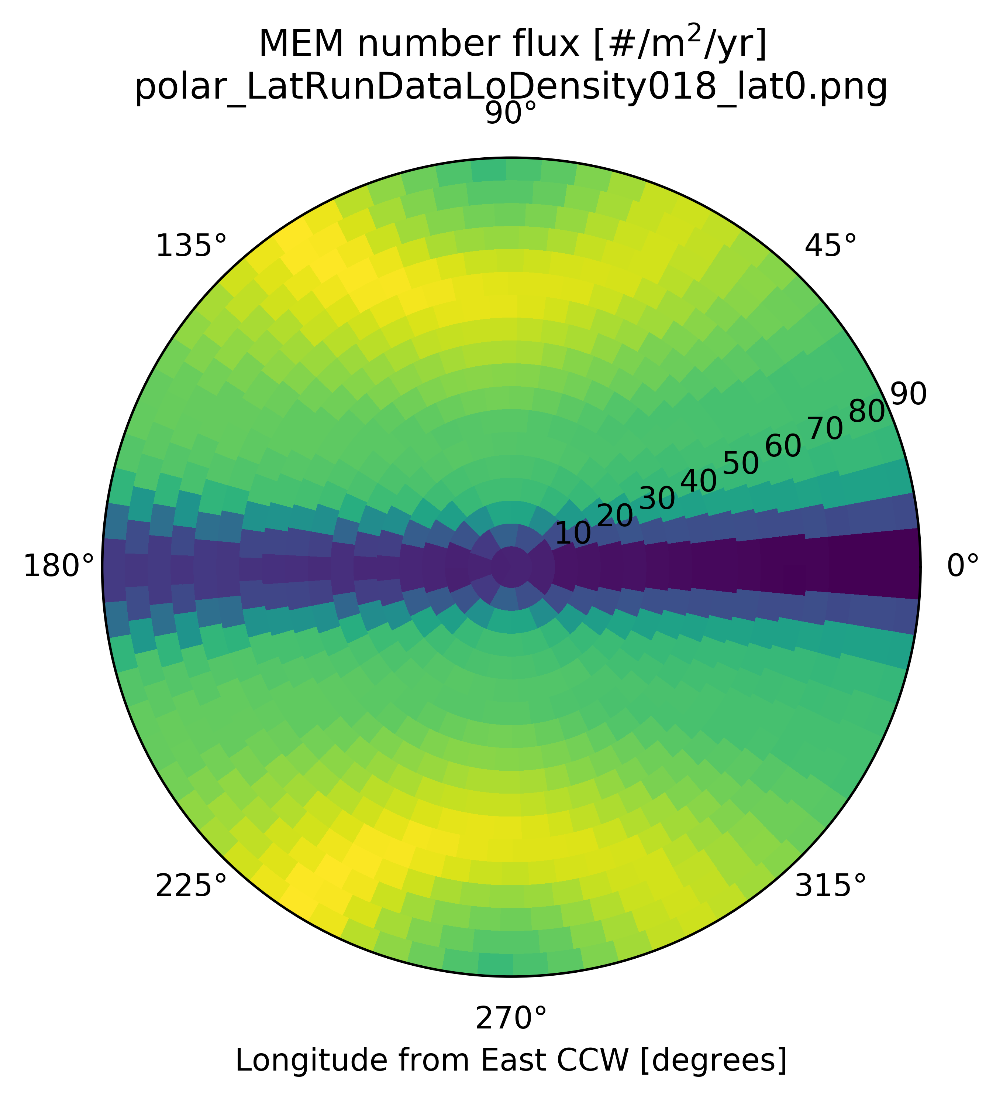
Sporadic meteoroid flux (alt/az) and latitudinal dependence on the lunar surface

Slide 21
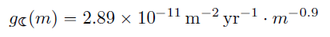
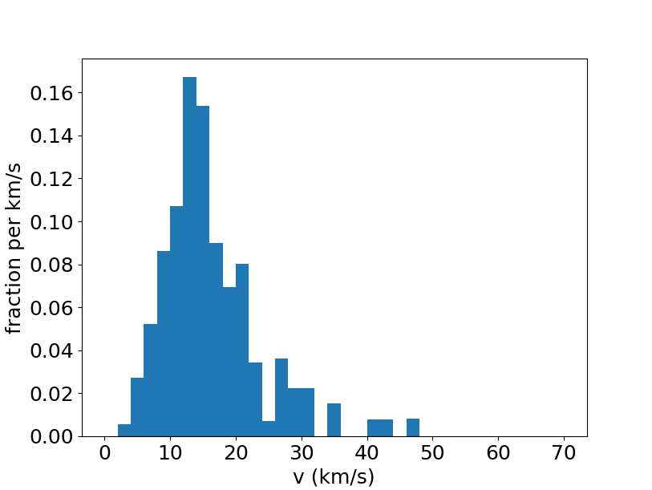
Near Earth Object (NEO) flux (Brown et al. 2002) at the lunar surface
Althea Moorhead (see memo OSMA/MEO/Lunar-001) computed the NEO flux at the lunar surface based on Brown et al. 2002 and velocity distribution of bolides reported by the Center for Near Earth Object Studies (CNEOS)
In MeMoSeE, we approximate the angular distribution of fluxes at the lunar surface by the high density population of MEM
The high density population in MEM comes from the equatorial plane, “similar to the NEOs”

Slide 22
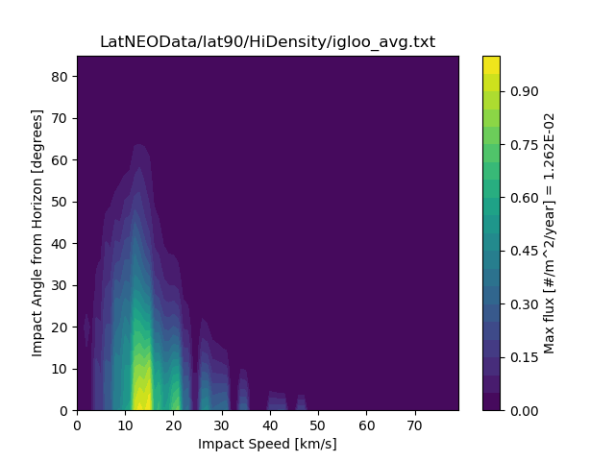
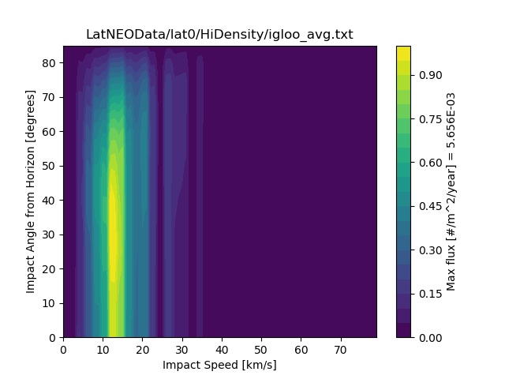
NEO flux and latitudinal dependence on the lunar surface

Slide 23
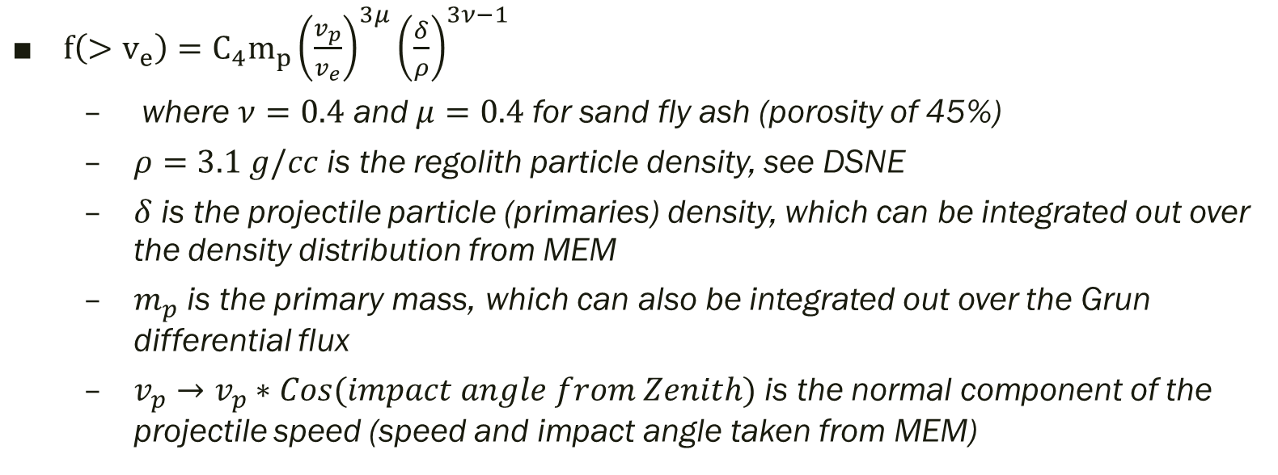
Impact-ejecta scaling model (Housen & Holsapple 2011)
$f\left(>v_{e}\right)=C_{4}m_{p}{\left(\frac{v_{p}}{v_{e}}\right)}^{3μ}{\left(\frac{δ}{ρ}\right)}^{3ν−1}$
where $ν=0.4$ and $μ=0.4$ for sand fly ash (porosity of 45%)
$ρ=3.1 g/cc$ is the regolith particle density, see DSNE
$δ$ is the projectile particle (primaries) density, which can be integrated out over the density distribution from MEM
$m_{p}$ is the primary mass, which can also be integrated out over the Grun differential flux
$v_{p}→v_{p}∗Cos(impact angle from Zenith)$ is the normal component of the projectile speed (speed and impact angle taken from MEM)

Slide 24
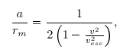
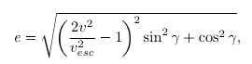
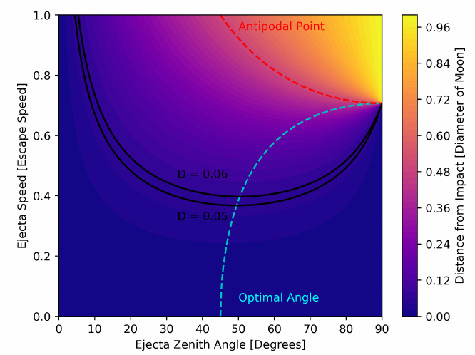
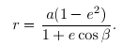
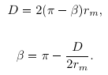
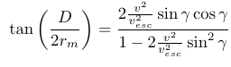
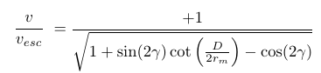
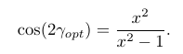
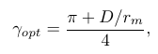
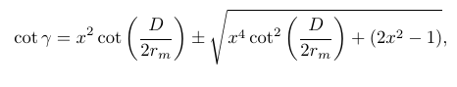
Trajectory and spherical geometry of secondary ejecta
Visual aid to guide intuition – converting ejecta at impact location to ejecta collected at Region-of-Interest
Orbital mechanics
Impact and ROI distance from lunar surface the same (trajectory is symmetric about the apoapsis/periapsis)

Slide 25
Integrating arbitrary domain – Step 1
Recursively break down the domain to find regions between the two curves
i.e., Search for ejecta angle/speed pairs that reach the ROI
Ejecta Speed
Ejecta Zenith Angle

Slide 26
Integrating arbitrary domain – Step 1
Recursively break down the domain to find regions between the two curves
i.e., Search for ejecta angle/speed pairs that reach the ROI
Ejecta Speed
Ejecta Zenith Angle

Slide 27
Integrating arbitrary domain – Step 1
Recursively break down the domain to find regions between the two curves
i.e., Search for ejecta angle/speed pairs that reach the ROI
Red regions are completely outside of the domain
Yellow regions are partially in the domain
Green regions are completely inside the domain
Ejecta Speed
Ejecta Zenith Angle

Slide 28
Integrating arbitrary domain – Step 2
Recursively break down yellow regions partially in the domain
i.e., Search for ejecta angle/speed pairs that reach the ROI
Red dots are completely outside of the domain
Green dots are completely inside the domain
Ejecta Speed
Ejecta Zenith Angle

Slide 29
Integrating arbitrary domain – Step 2
Recursively break down yellow regions partially in the domain
i.e., Search for ejecta angle/speed pairs that reach the ROI
Red dots are completely outside of the domain
Green dots are completely inside the domain
Only green dots are where the integral is evaluated
Ejecta Speed
Ejecta Zenith Angle

Slide 30
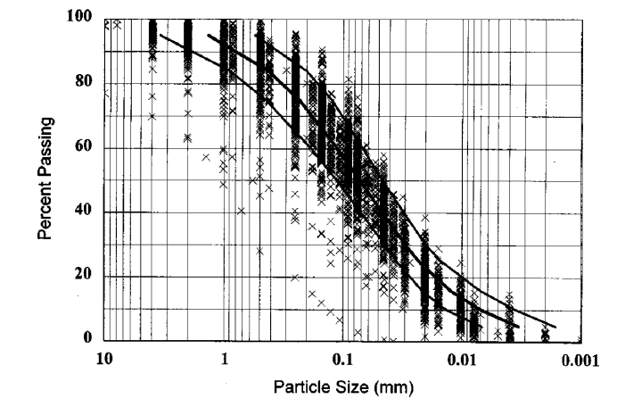
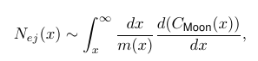
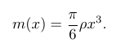


Ejecta particle size distribution (Carrier 2003)
Carrier 2003 gives the cumulative particle size distribution normalized by mass and not particle number
To convert to particle number, we need to evaluate the integral:
It can be shown that the cumulative particle size distribution normalized by number is (x in mm):
$N_{ej}\left(x\right)\sim \frac{2.7695×{10}^{−4}}{{\left(\frac{x}{0.7126}\right)}^{4.3026}+x^{2.8849}}$
Note that SP-8013 gives: $N_{ej}\left(x\right)\sim x^{−3.6}$
Size range of LADEE/LDEX observations (0.1 – 5 um, Horanyi et al. 2014)
-- They show $N_{ej}\sim x^{−2.73}$ in this regime (Horanyi et al. 2015)

Slide 31







Ejecta zenith angle distribution (empirically from Gault & Wedekind 1978)
The maximum ejecta zenith angle as a function of ejecta azimuth from the down stream direction of the primary impact:
Zenith angle distribution (formally, a beta distribution in cosine of the zenith angle):
Defined so that α_max is the peak of the distribution

Slide 32



Ejecta azimuth angle distribution (modified from Rival & Mandeville 1999)
The azimuth distribution is defined so that the downstream direction is preferred if the impact zenith angle $α_{i}$ is not normal
If there is a normal impact, the azimuth distribution is isotropic
For oblique impacts (greater than 70 degrees), the azimuth distribution begins to have an exclusion zone in the upstream direction, defined by $Δβ_{ez}$

Slide 33







Ejecta full angular distribution

Slide 34
Backup

Slide 35
Overview
Results of LuMEM
Igloo number flux distribution (based on MEM3, see Moorhead et al 2019)
Example DSNE Table for Rev. I
HVIT Probability of No Penetration (PNP) Comparison
DSNE Rev H Lunar Ejecta Model – NASA SP-8013 (1969)
Based on Zook 1967
Brief (non-exhaustive) Review of Impact-Ejecta Scaling Models
Zook 1967
Krivov et al. 2003
Housen & Holsapple 2011
Proposed New DSNE Model -- Meteoroid Model of Secondary Ejecta (MeMoSeE)
Sporadic meteoroid flux (Grun et al 1985)
Near Earth Object (NEO) flux (Brown et al 2002)
Impact-ejecta scaling model (Housen & Holsapple 2011)
Ejecta particle size distribution (Carrier 2003)
Ejecta zenith angle distribution (empirically from Gault & Wedekind 1978)
Ejecta azimuth angle distribution (modified from Rival & Mandeville 1999)
Analytic model of lunar ejecta
Speed distribution as a function of distance
Secondary flux as a function of distance
Secondary flux in terms of primary flux

Slide 36










Speed distribution as a function of distance
Differential area
Azimuthal field-of-view
Ejecta speed distribution
Geometric factor

Slide 37

Distance distribution as a function of speed
Each integral over the distance for each speed gives a weight of 1
For speeds less than sqrt(2)/2 (or < 0.7071 * v_esc)
A very specific distance (a ring around the ROI) contributes to a given ejecta speed
For speeds greater than 0.7071 * v_esc and less than ~0.9 * v_esc
A range of distances from ~0.35 to 0.6 * circumference of Moon (like a hemispherical cap centered at the antipode) contribute to a given ejecta speed
For speeds greater than ~0.9 * v_esc
Distances greater than ~0.4 * circumference of Moon, which is the entire Moon contributes to a given speed

Slide 38


Secondary flux as a function of distance
The ejecta speed distribution as a function of distance from primary impact point follows a power-law for all distances
We see that the secondary fluxes are dominated by impacts that are close by (when taking into account the power-law speed distribution from Housen & Holsapple 2011)
There is a correction factor to the power-law relation that only varies by about 10% over the whole Moon for $μ=0.4$ (the antipodal location is underestimated, which is a minor contribution to the over flux)

Slide 39



Secondary flux from impacts over the whole Moon in terms of secondary flux from a single impact on the Moon
Secondary flux as a function of ejected angle from zenith
Secondary flux if all ejecta is ejected at 45 degrees
Secondary flux assuming isotopically ejected ejecta, shown to be comparable to ejecta only at 45 degrees
E.g., if v_min = 100 m/s, then the size of the ROI must be << 5.2 meters, otherwise higher terms come into play
From HH11 scaling laws

